Slide 1
Annals of Dagobah A Data analysis of Star wars & Star Trek Fandom
Presented by:
The data swamp sages of dagobah
‘darth’ stan smith
Luke ‘skywalker’ Williams
Sanhita ‘picard’ Banerjee
‘Nyota’ Yurora saylor

Slide 2
The Backstory
From the beginning when Star Trek was first introduced as a TV series in 1966 and Star Wars became a movie blockbuster hit when it debuted in 1977, there has been an intense rivalry between Trekkies or Trekkers (Star Trek fans) and Star Wars loyal fans.
Notes:
From the beginning when Star Trek was first introduced as a TV series in 1966 and Star Wars became a movie blockbuster hit when it debuted in 1977, there has been an intense rivalry between Trekkies or Trekkers (Star Trek fans) and Star Wars fans. Both franchises have something to offer for anyone interested in the Sci-Fi and Action genres.
Both have something to offer fans, but what demographics does a “typical” Star Trek or Star Wars fan have?

Slide 3
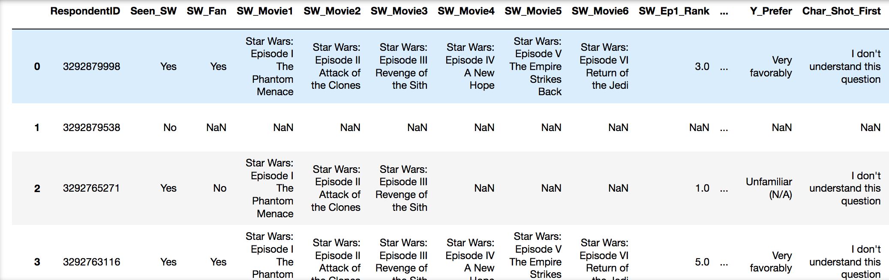
Star Wars Survey Data
Source: - https://github.com/fivethirtyeight/data/tree/master/star-wars-survey
Notes:
The dataset, 'StarWars.csv', is a survey that was behind the FiveThirtyEight's story, "America’s Favorite ‘Star Wars’ Movies (And Least Favorite Characters)" written by Walt Hickory where 1186 responses were gathered from a SurveyMonkey Audience they conducted.

Slide 4
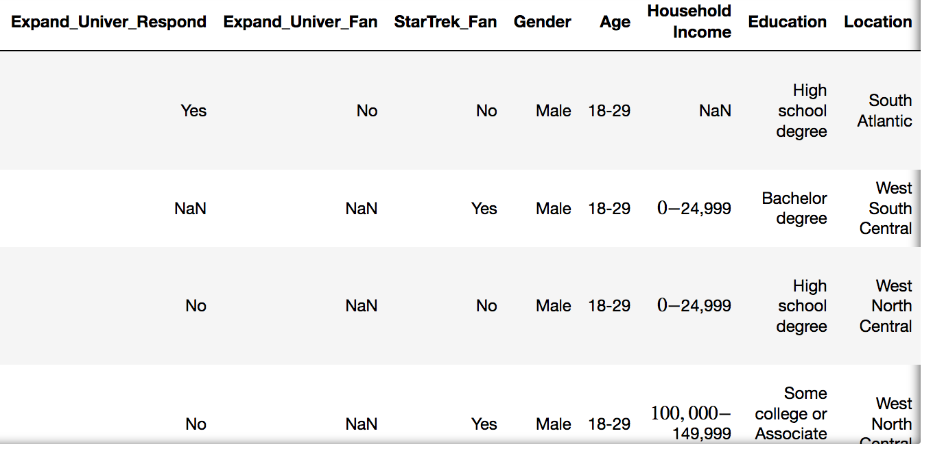
Star Wars Survey Data
Source: - https://github.com/fivethirtyeight/data/tree/master/star-wars-survey
Notes:
The dataset, 'StarWars.csv', is a survey that was behind the FiveThirtyEight's story, "America’s Favorite ‘Star Wars’ Movies (And Least Favorite Characters)" written by Walt Hickory where 1186 responses were gathered from a SurveyMonkey Audience they conducted.

Slide 5
Star Wars Survey Data
Questions Considered for Analysis
Are you a Star Wars Fan?
Are you a Star Trek fan?
What is your education level?
Source: - https://github.com/fivethirtyeight/data/tree/master/star-wars-survey
Notes:
Astrophysicist Neil deGrasse Tyson was quoted in his October 2015 Rolling Stone interview: “I'm ‘Star Wars’ fluent, but I'm a bigger ‘Trek’ fan. There's a promise of actual science going on in ‘Star Trek’ but not so much in ‘Star Wars.’”
So here we have a World reknown Astrophysics with 2 Masters and 1 PH.D that is a Star Trek fan. Which brings the following questions:
Are you a Star Wars Fan?
Are you a Star Trek Fan?
What is your education level?
The dataset, 'StarWars.csv', is a survey that was behind the FiveThirtyEight's story, "America’s Favorite ‘Star Wars’ Movies (And Least Favorite Characters)" written by Walt Hickory where 1186 responses were gathered from a SurveyMonkey Audience conducted.

Slide 6
The Question? Among Star Wars fans, is there a correlation between Education level and being a Star Trek Fan?
Notes:
Does ones level of education background make them more susceptible with being a Star Wars fan only, a Star Trek fan only or both?

Slide 7
Hypothesis Among Star Wars fans is there is a positive correlation between education level and being a star trek fan. Null Hypothesis There is no direct correlation between education level and being a star trek fan among Star Wars fans.

Slide 8
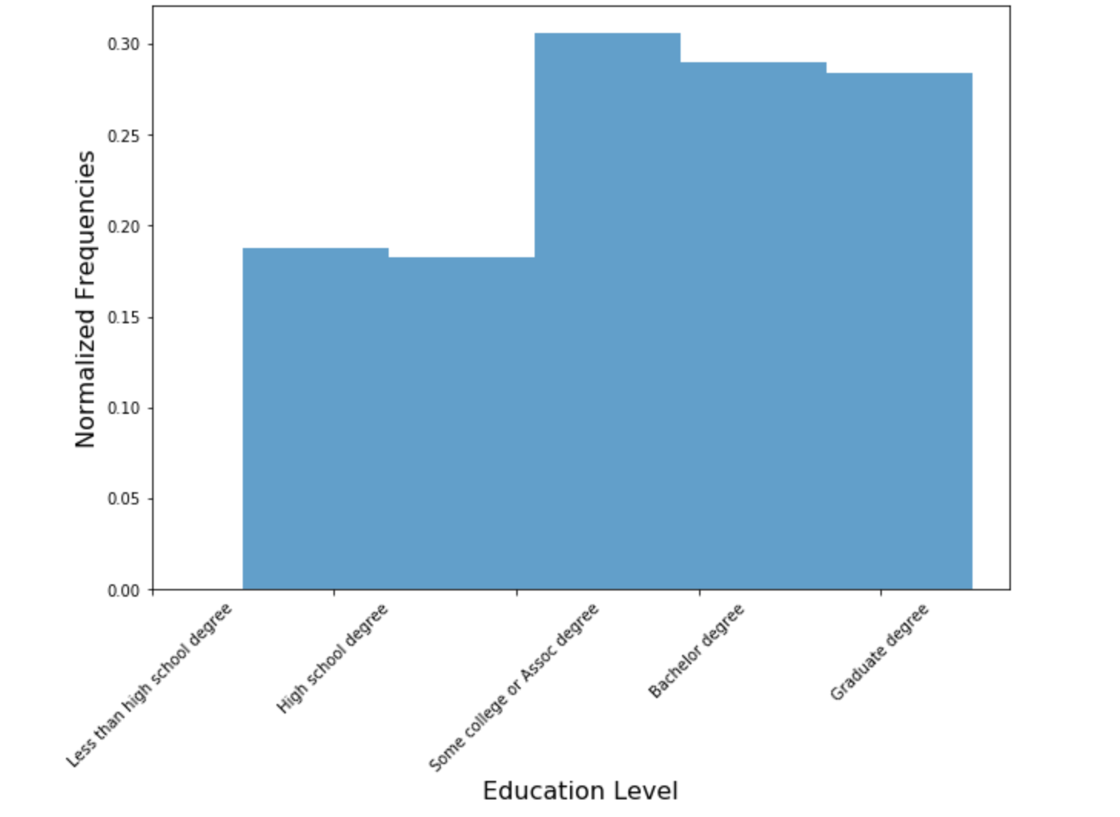
Star Trek Fans By Education Level
Notes:
First we had tp normalize data and

Slide 9
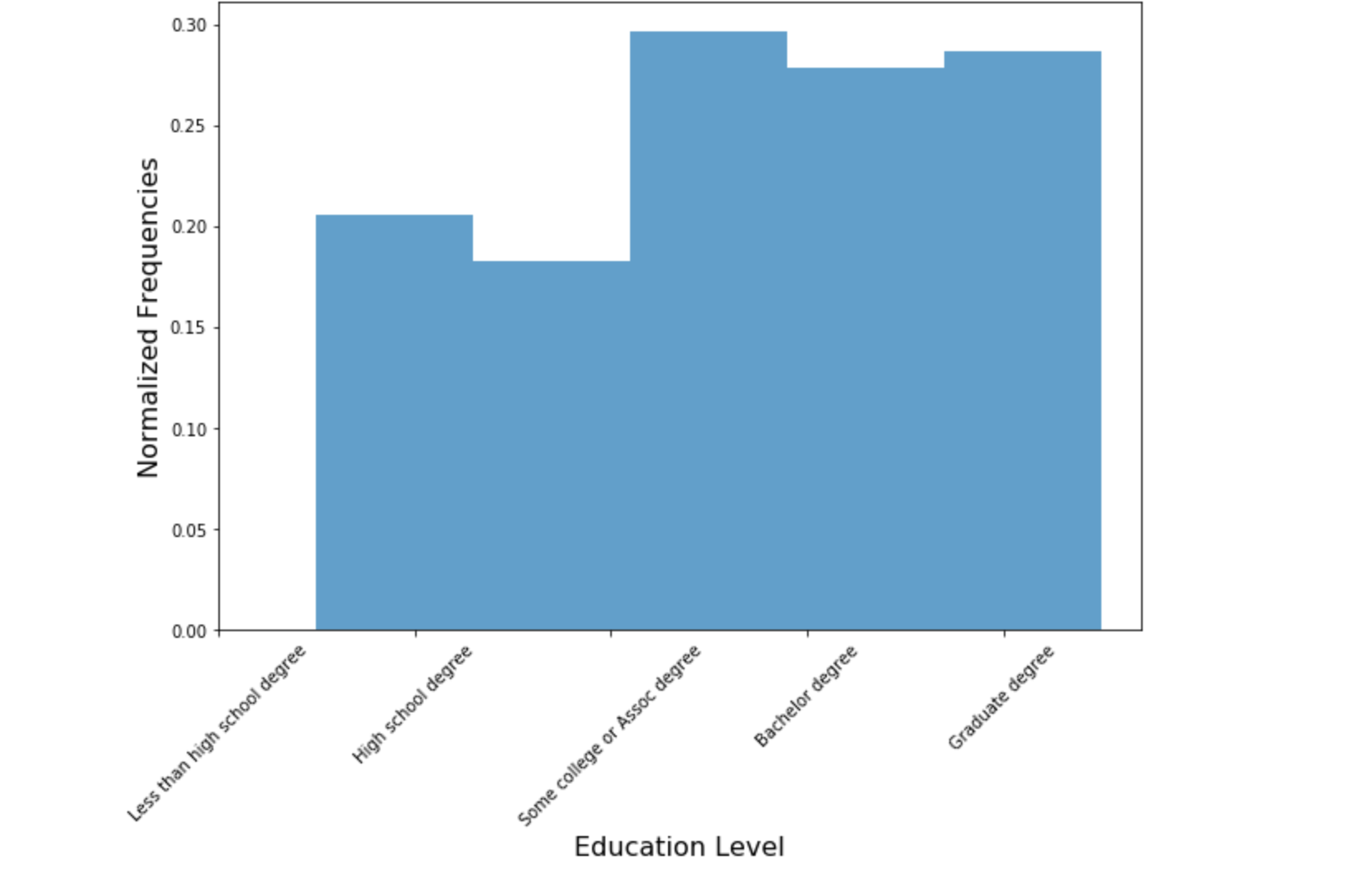
Star Trek And Star Wars fans by education level

Slide 10
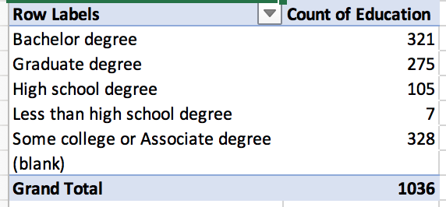
Survey Data Grouped by Education

Slide 11
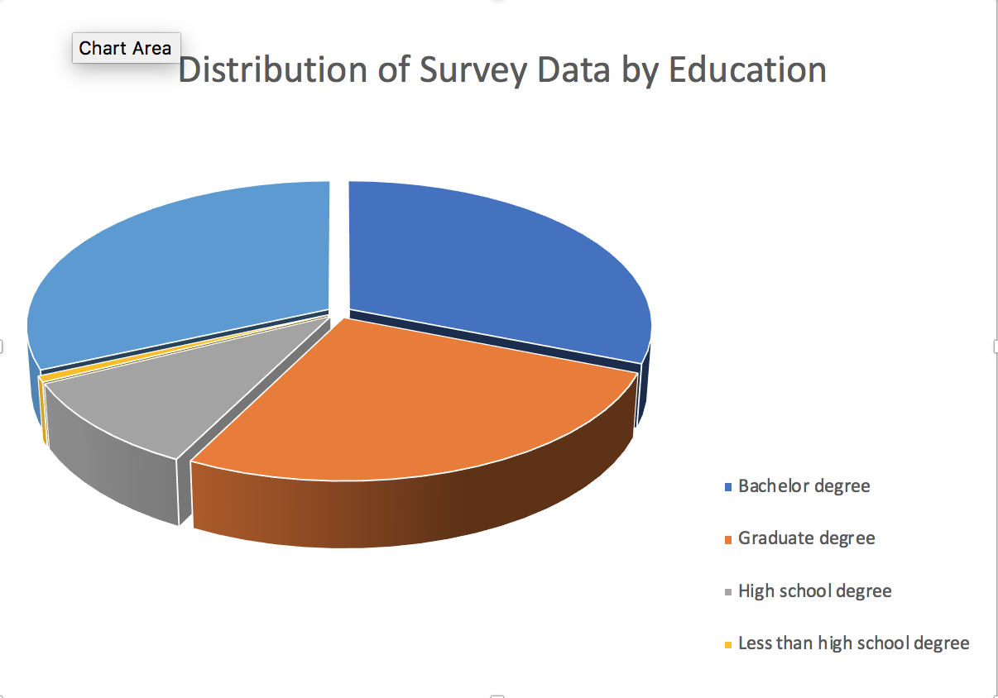

Slide 12
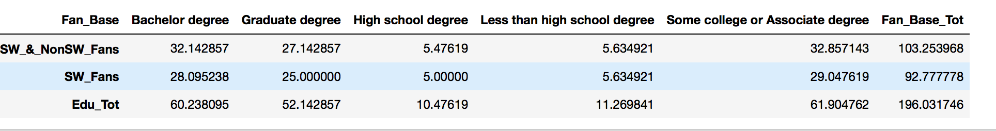
Contingency table to calculate correct, Expected distribution for Chi Square test between two observation distributions.

Slide 13
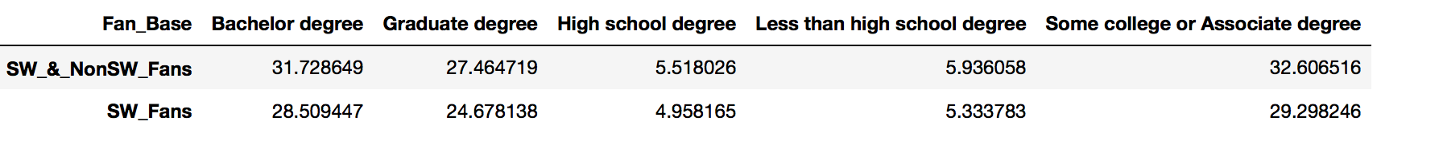
Expected Values table based on Contingency table
Create a Contingency table to caclulate correct, Expected distribution for Chi Square test between two
# observation distributions.
Create a Contingency table to caclulate correct, Expected distribution for Chi Square test between two
# observation distributions.

Slide 14
Conclusions
Chi Square Critical Value: 9.48
The Chi Square Statistic for Star Trek fans: 0.026
The P-value for Star Star Trek fans: 0.999
The Chi Square Statistic for Star Wars fans who are Star Trek fans: 0.029
The P-Value for Star Wars fans who are Star Trek fans: 0.999
The total Chi Square Statistic: 0.026 + 0.029 = 0.056
The total Chi Square Statistic of 0.056 is less than our Critical value of 9.487.
Thus, the difference between our two distributions is not significant.
The total P-Value Statistic: 0.999 x 0.999 = 0.999
The total P-Value Statistic of 0.999 is far greater than our significance P-Value of '.05’.
Thus, the difference between our two distributions is not significant.

Slide 15
The final word
We accept our Null Hypothesis

Slide 16
Future Ideas
Conduct more extensive demographic analysis during data exploration phase to look for basic correlations among data
Conduct API requests of databases such as OMDB in order to help validate this survey
Conduct logistic regression analysis to parse out variables that may correlate with Star Trek “fandom”

